Slide 2
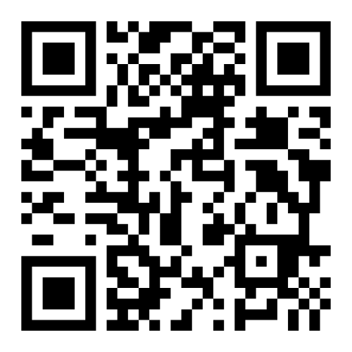
ISEH 2025
24 – 27 September
Kumamoto Castle Hall
Kumamoto, Japan
Abstract Deadline: 19 May
Late-breaking Abstract Deadline: 16 July
Housing Deadline: 5 August
Early Registration Deadline: 7 August
Learn More at www.iseh.org/iseh2025

